Slide 1








M2M Cloud-based Platform
Data Traffic Management and Control
M2M Market
M2M Applications
The total M2M connections will grow from 62 million in 2010 to 2.1 billion in 2020, with an annual rate of 36%.
M2M connections will be 19% of the total amount of mobile connections in 2020, with mobile carriers reaching €40 billion revenue in this €714 billion market.
Vehicle tracking – GPS
Logistics Management
Public Transportation
Security and Asset protection companies
Utilities
Payment Systems
Sales Force Automation
E-Health
ATM’s
M2M Problems
Our M2M Solution
P
Private APN and M2M Platform
M2M Corporate Intranet
Static, private IP’s
Asset manager for equipments and SIM cards
Bandwidth and internet data control
Access Control with firewall
CDR (call detail record) for managerial reports
Safety and revenue guarantee
Fraud prevention and detection
R
L
O
S
S
F
R
I
S
K
T
Increasing Fraud
  Fraud growing due to M2M services
  M2M companies out of market
  Millions in lost revenue by carriers
Public IPs Availability and Security
  Public IPs are a limited resource
  Unwanted traffic from hackers, search robots, and other attacks when using public IP addresses.
Asset Management Problems
Cloud-based M2M Platform with 100% Web-based Management Tool
  Bandwidth is an expensive resource
  Customers don’t acknowledge data cost in phone their bills
  Revenue loss due to lack of management capabilities for Assets and Chips.
LeadingQuest – USA & Brazil

Slide 2
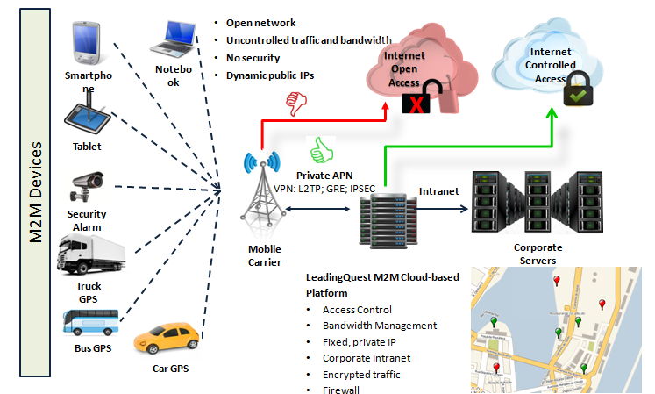



M2M Cloud-based Platform
Data Traffic Management and Control
M2M Cloud-based Platform
M2M - Benefits
Mobile Carriers
Enterprise M2M
Use of Private IP's to save the public IP’s stock
Guarantee of revenue, cutting millions in unpaid invoices
Fraud prevention, eliminating unwanted traffic
Better performance of data infrastructure
Optimizing internet bandwidth use
Static, private IP – M2M Corporate Intranet
Quick implementation – 100% web-based applications
Safe transactions, protecting and securing data
Platform for every M2M application
Multiple carriers support
High performance Data Centers in the USA
Detailed utilization reports, for better management
Cutting operational cost with asset management and increased productivity in operations due to efficient asset management
New service opportunities
LeadingQuest – USA & Brazil

Slide 3

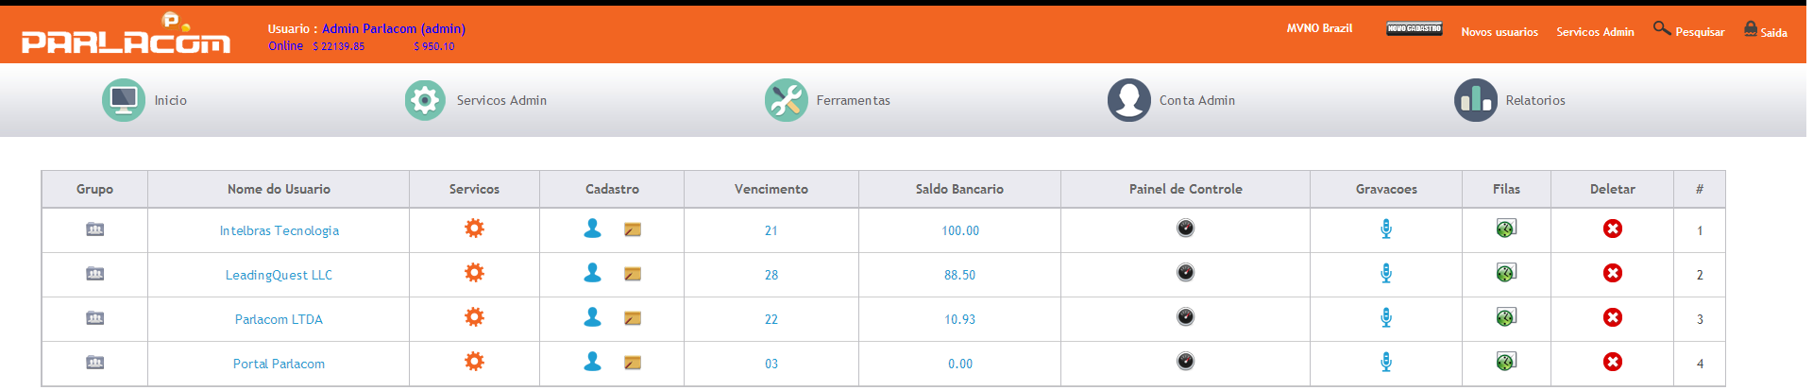
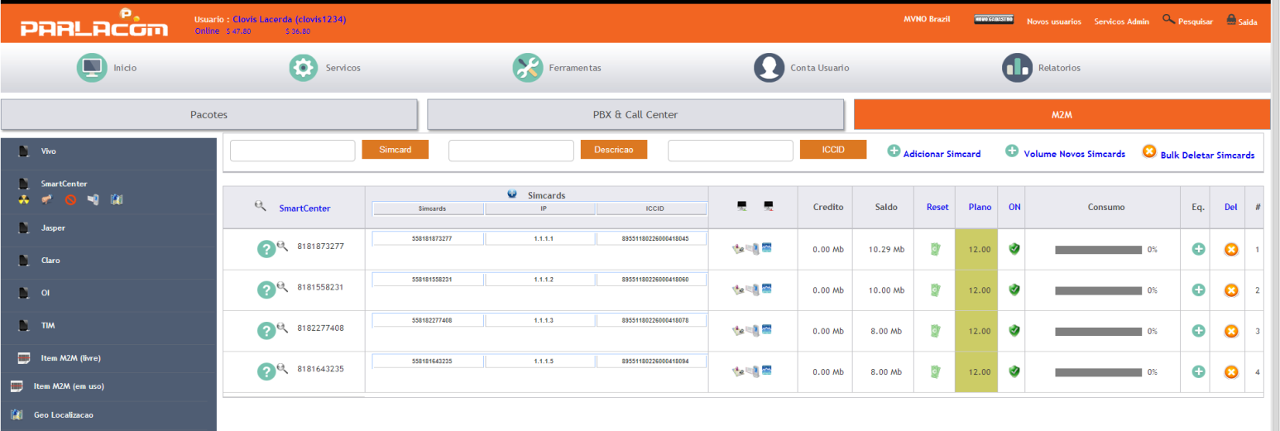
M2M Cloud Platform
Data Traffic Managing and Control
SMS – Sending and Receiving Messages
Multiple Resources:
Sending SMS via web portal
Sending SMS via Gtalk
Sending SMS via your system, with our integration API’s
Receiving SMS via email
Automated campaigns
Exclusive tags to receive SMS
M2M Platform
Traffic control; MDM; mobile apps
Voice and Data: Telephony (PBX, Call Center, MVNO) and M2M
Multiple hierarchy with no limits, multiple users
Private Label; fully customizable; 100% web-based
Integrated APIs
Multiple carriers: Vivo M2M/Smartcenter, Claro, Oi, TIM, Optimus/Jasper, Vodafone/Datora
VPNs; customised firewall; IP Proxy; Geolocation; SMS
LeadingQuest – USA & Brazil

Slide 4
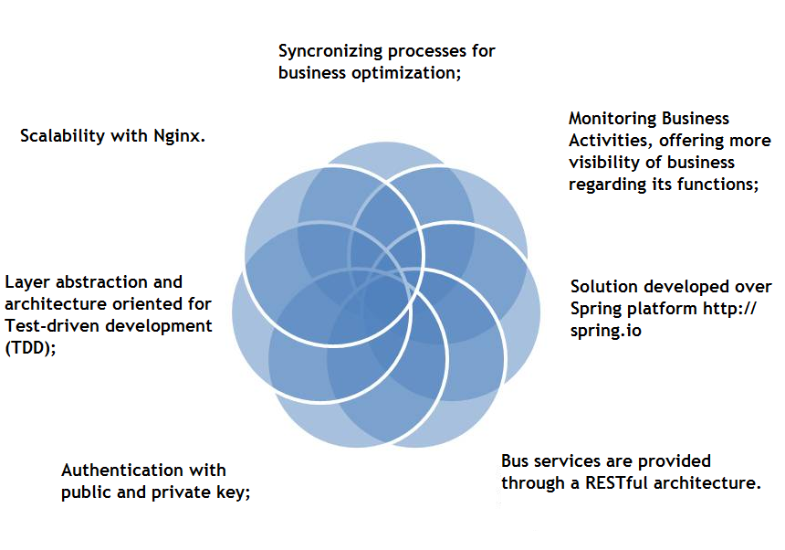
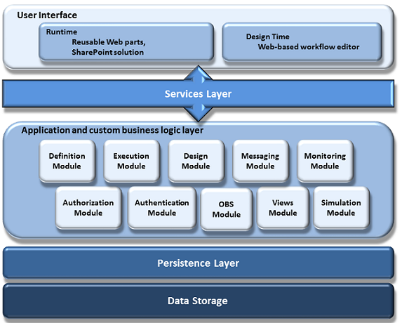
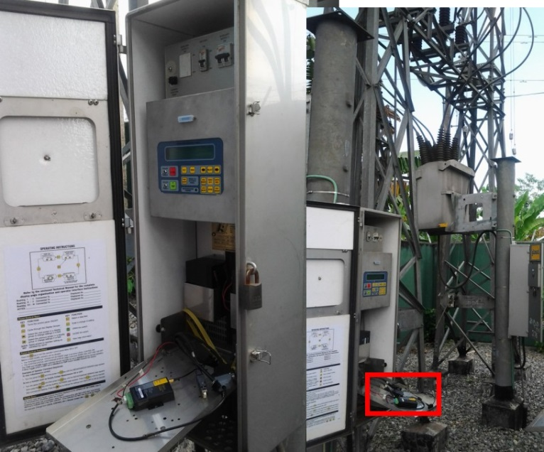
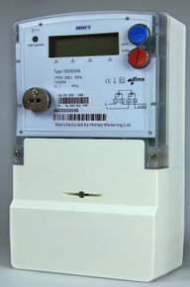
M2M Cloud Platform
Data Traffic Managing and Control
SIMPLIFIED CONNECTIVITY, ALLOWING A UNIFIED EXPERIENCE FOR CLOUD INTEGRATION, LOCAL AND BUSINESS-TO-BUSINESS
With the use of Enterprise Service Bus (ESB) as the basis for shared services.
Vertical Markets
Smart Grid
Smart grid is the use of information technology for the electric system, integrated to the communication systems and the automated network infrastructure.
LeadingQuest – USA & Brazil

